Slide 1
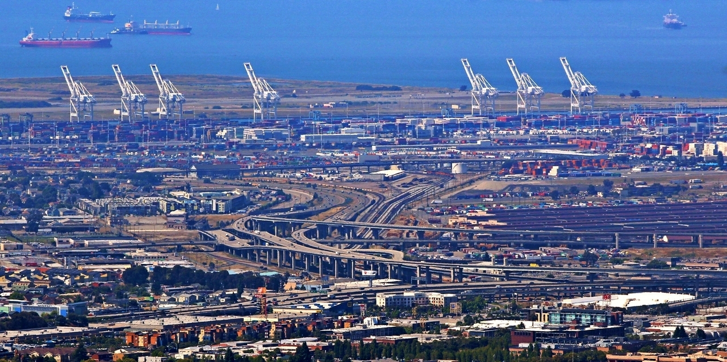
Making a Class Website
22 Feb 2017
Dr. Greg Erhardt
greg.erhardt@uky.edu CE599-002 Spring 2017

Slide 2
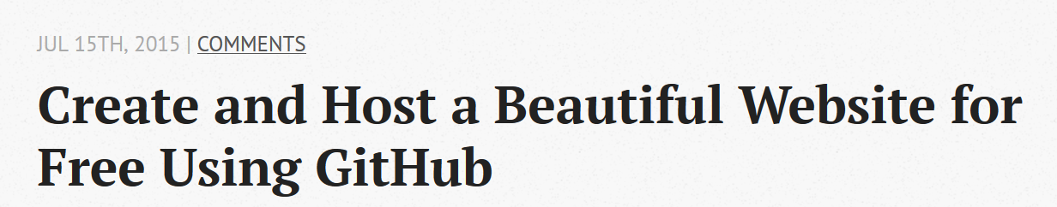
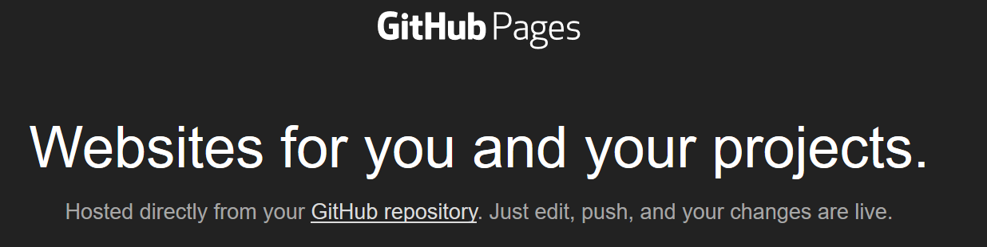
Tutorials
http://blog.revolunet.com/blog/2015/07/15/beautiful-static-website-in-minutes-with-github/
https://pages.github.com/

Slide 3
Initial Website Setup
Part 1: Me First

Slide 4
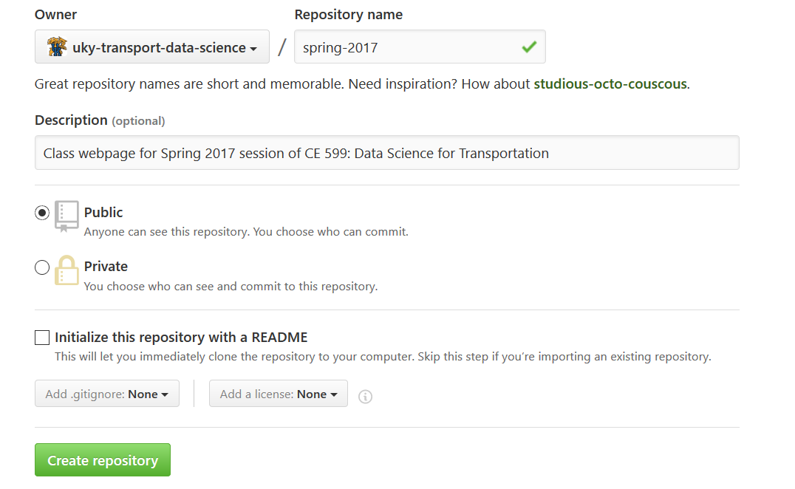
1. Create a new repository
This will create a page at: http://username.github.io/repository
Or you can create a repository called username.github.io to create a webpage at: http://username.github.io

Slide 5
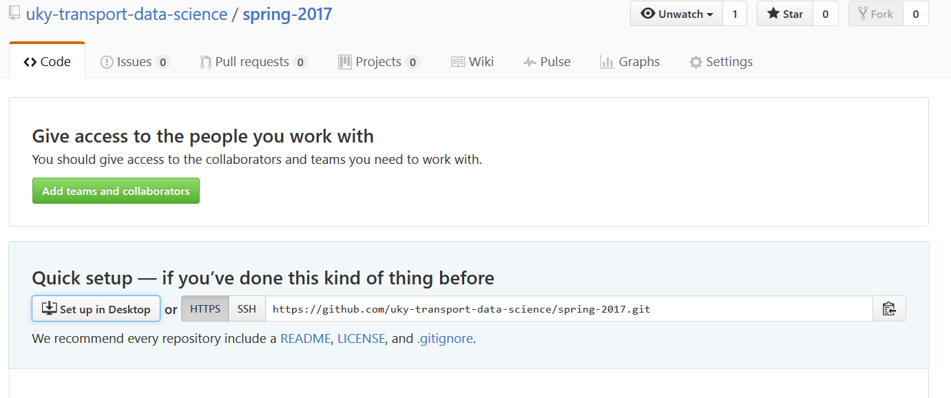
2. Set up and clone the repository

Slide 6
3. Make an index file
Create a file called index.html and write some text.
Or add some basic HTML formatting:
https://www.w3schools.com/html/html_basic.asp
https://www.cheatography.com/davechild/cheat-sheets/html4/

Slide 7
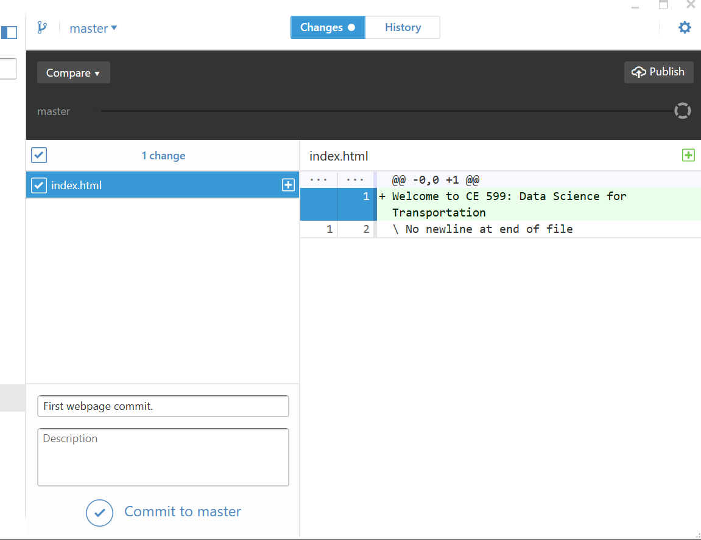
4. Commit the change, and publish (sync)

Slide 8
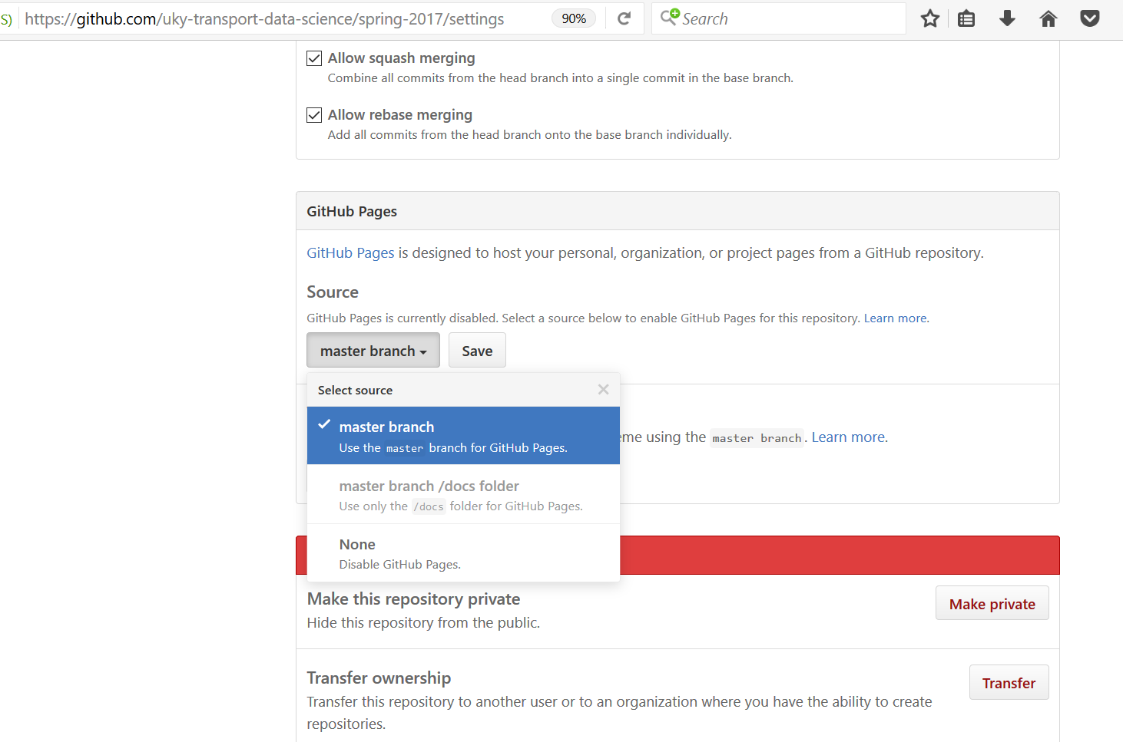
5. Set repository to enable Github pages

Slide 9
See the result!
https://uky-transport-data-science.github.io/spring-2017/
Also, you can view the local copy by opening the HTML file in a browser. Your browser address will show something like:
file:///C:/WORKSPACE/uky-transport-data-science/spring-2017/spring-2017/index.html
This is useful if you want to see what it looks like before you publish it.

Slide 10
Version Control with Multiple Users
Part 2: You Edit

Slide 11
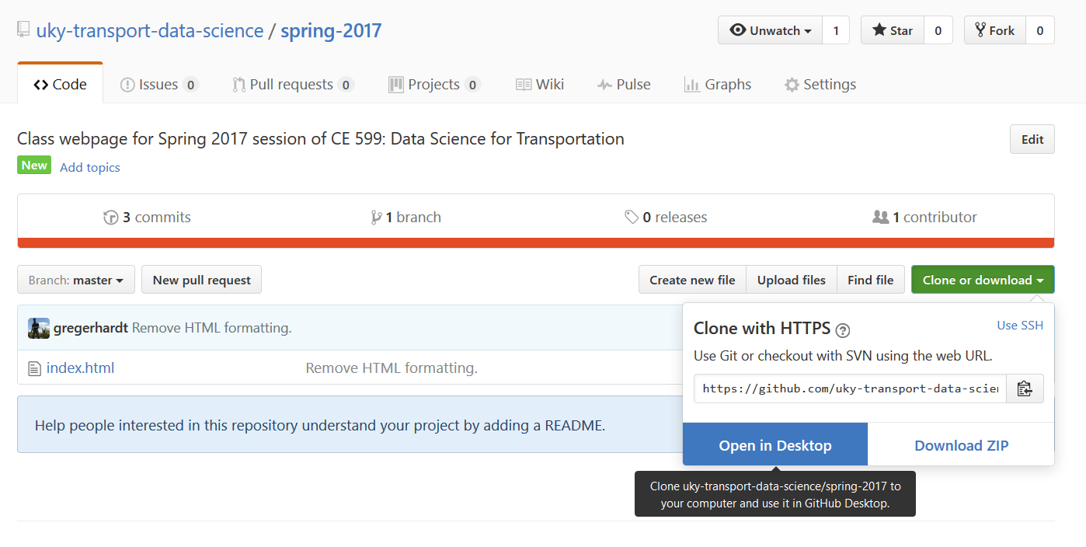
Clone the repository to your own desktop

Slide 12
All at the same time
Add a few lines of text to index.html, then commit and sync it.
What happens?

Slide 13
Let’s try again…
Delete the repository from your desktop, and clone a fresh copy.

Slide 14
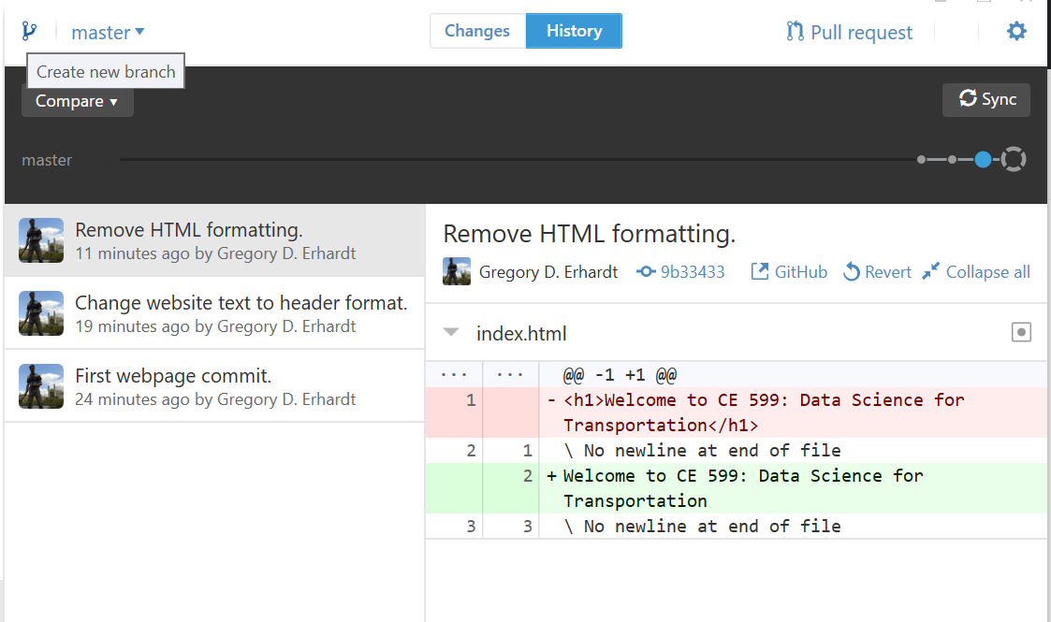
This time, create a branch.

Slide 15
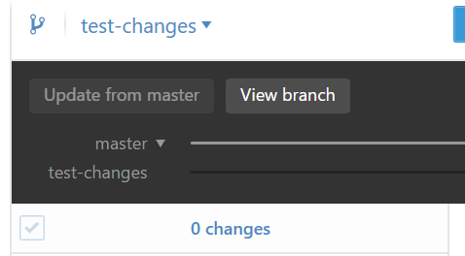
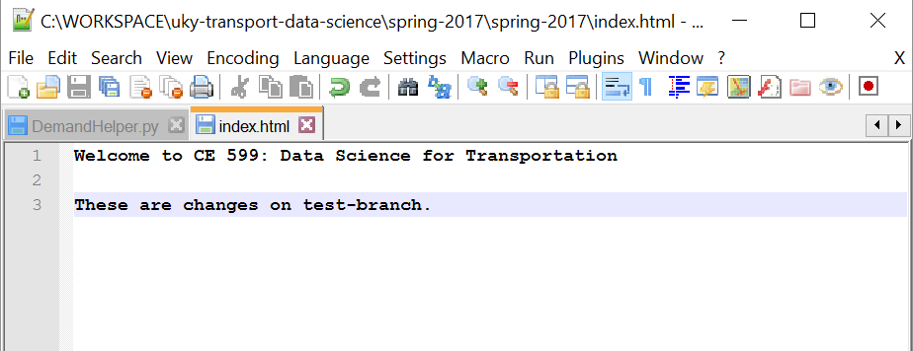
Make some changes
Make sure you are on the right branch.
Add some text to index.html and commit.

Slide 16
Observe
Notice that the history is different between the two branches.
What happens to the files on your hard drive when you switch branches?
Now, publish your branch.
Can you see everyone else’s history?

Slide 17
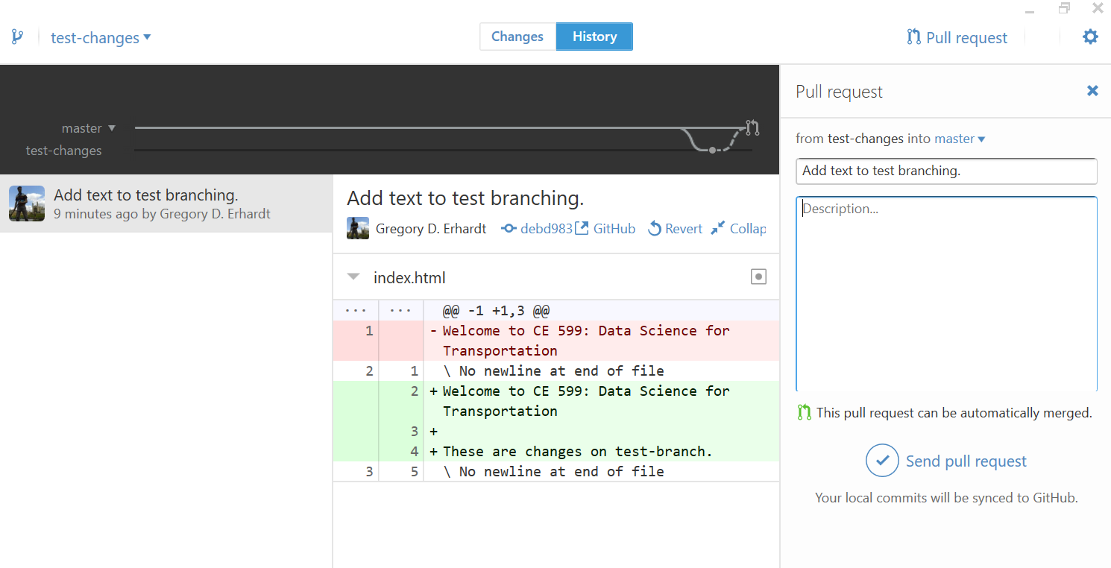
Create a pull request: One at a time!
To bring these changes back to the master, create a pull request.

Slide 18
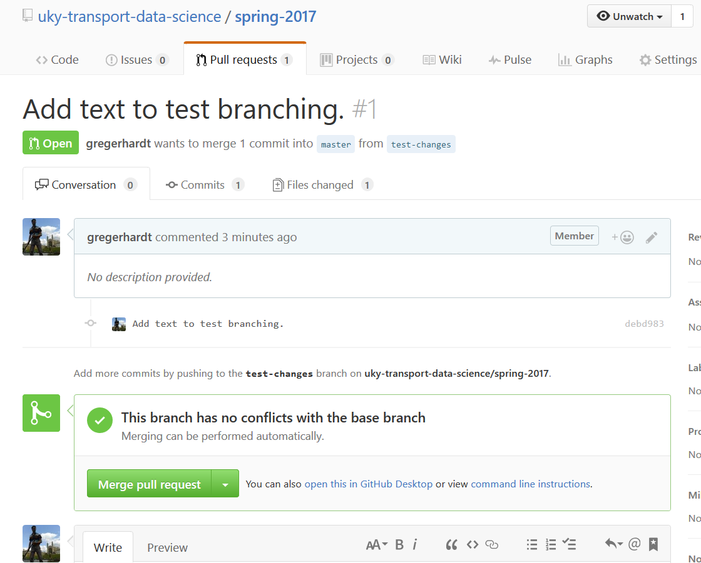
Review & merge pull request: Someone else!

Slide 19
Why?
With multiple committers, someone needs to be in charge. They will review changes, edit files to resolve conflicts, and so forth. In effect, they are the project manager.
The workflow is explained nicely here:
https://guides.github.com/introduction/flow/
Similar strategies apply beyond software. What happens when the sign designer and the drainage design each want to put a feature in the same place?

Slide 20
Back to Our Webpage
Part 3: Together

Slide 21
Templates
I don’t have the patience to learn HTML from scratch, so let’s start from a template.
Some good (and free) options are here:
https://startbootstrap.com/
https://html5up.net/
Pick one you like, download it, and start to tinker around.

Slide 22
Homework
Your assignment this week is to create a class webpage. Start from a template you like, and customize it to the course. It should:
Have a basic intro to what the class is about.
Feature each student and the instructor with a picture and a blurb.
Feature each of your term projects with an image and description. Include a placeholder if you are still deciding.
Be appropriate for public consumption.
Look polished—this is a chance to show off.

Slide 23
Homework
You should nominate a project manager who will be responsible for merging pull requests and general coordination. Everyone is responsible for content.
I will be in San Diego for a project interview on Tuesday. You are still required to attend class and should use the time working as a group to complete your webpage.
If you need inspiration, check out mine: http://transportlab.net/

